Slide 1
Reinforcement Learning
A brief overview
Anthony Winder
Statistical Learning Study Group
May 17 2019

Slide 2
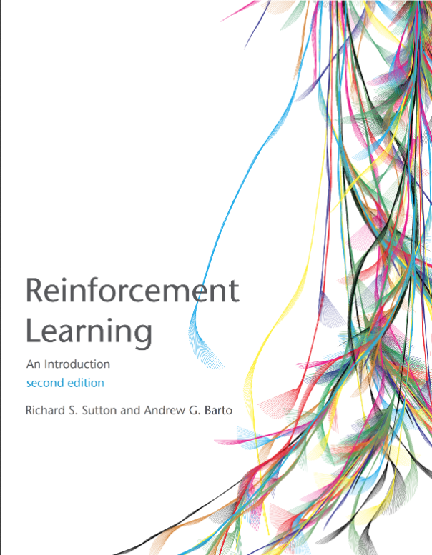
Resources
Reinforcement Learning: An Introduction. Richard S Sutton and Andrew G. Barto. MIT Press, Cambridge, MA, 2018
First seven(ish) chapters covered in this talk.
Notes:
Covers the first six and part of the seventh chapters from this really good reinforcement learning textbook

Slide 3
Topics
Common definitions
Theory of RL ‘building blocks’
Foundational algorithms:
Reinforcement Learning
Monte Carlo Methods
Temporal Difference
Sarsa/Q
Notes:
Reinforcement learning is a method for developing a model to answer the common question “What should I do?” it naturally asks the follow-up question “Well, what do you want to achieve?” which requires some formal terminology to answer.
If you can administer appropriate rewards to dictate what you want to achieve, reinforcement learning can help inform you of what you should do.

Slide 4
Terminology - State
…
r_{a|s}
s_{n}
a
s_{n+1}
…
Markov property:
the state contains all prior information that makes a difference for the future.
s ∈ S
Notes:
The ‘state’ defines the relevant variables in the agent’s environment
Must be a complete description of all relevant variables for the algorithm to converge on the optimal solution (Markov)

Slide 5
Terminology - Action
…
r_{a|s}
s_{n}
a
s_{n+1}
…
a ∈ A(s)
Notes:
The ‘action’ is the transition to the next state. Usually, the agent has some control over its environment and chooses from many actions, affecting the next state as a result.

Slide 6
Terminology - Reward
…
r_{a|s}
s_{n}
a
s_{n+1}
…
r ∈ R(a,s)
Notes:
The reward is a signal passed to the agent that is used to modify the relative probability of taking A from S.

Slide 7
Terminology - Policy
…
r_{a|s}
s_{n}
a
s_{n+1}
…
π(s) = a
Notes:
The policy is a function that maps each state to an action. It’s used to control the agent.

Slide 8

Terminology – Value Function
…
r_{a|s}
s_{n}
a
s_{n+1}
…
Notes:
The value function describes the expected return (sum of rewards) from starting at state S and following policy pi. Gamma is an exponential recency weighting factor that is used to favor immediate over future reward. It is essential if you have an infinite number of state-action transitions, since the expected return would be infinite otherwise.

Slide 9
Policy Optimization
5
r=5
6
7
10
r=10
r=1
v_{π}=8
11
S_{t}
r=0
r=5
12
5
6
(Assume Υ=1)
r=10
10
Notes:
Consider an episodic non-discounted problem where each state has two actions. The upper action yields a reward of one, while the lower action yields a reward of zero. The last set of states has only one action with a reward of 5 or 1, and goes to the terminal state.
A simple policy is to always take the upper path. The number in each circle represents the value function of that state given the policy that we just defined (the expected return if you start in that state and only take the top action).

Slide 10
Policy Optimization
5
r=5
6
7
10
r=10
r=1
v_{π}=8
11
S_{t}
r=0
r=5
12
5
6
(Assume Υ=1)
r=10
10
Notes:
It’s easy to see that after the first action, taking the lower action would improve our return.
We can consider a new policy that always takes the upper action unless it is in that particular state (the one with a current value of 7), in which case it always selects the lower action.
Now we must re-evaluate the value function for the new policy.

Slide 11
Policy Optimization
5
r=5
6
11
10
r=10
r=1
v_{π}=12
11
S_{t}
r=0
r=5
12
5
6
r=10
10
π ≥ π’ ⇔ v_{π}(s) ≥ v_{π’}(s) ∀ s∈S
Notes:
Everywhere that the value function was changed, the new result was greater. Therefore, our new policy pi prime is better than the original policy pi.
Formally, a policy is considered to be an improvement on another if and only if the value functions are equal or greater for all states.
Note that this policy can be improved again. Anywhere that the current value function is 6, taking the lower action would improve it to 10.

Slide 12
Policy Optimization
5
r=5
10
11
10
r=10
r=1
V_{π}=12
11
S_{t}
r=0
r=5
12
5
10
(Assume Υ=1)
r=10
10
Notes:
If we consider these two policy changes and re-evaluate our value functions, we can see that once again, our value function is equivalent or greater for all states.
In fact, the value of each state is as high as it can possibly. For a Markov decision process, there is only ever one optimal value function.
Any and all policies which are greedy with respect to the optimal value function are optimal policies. There are three policies shown here which are all greedy with respect to the shown (optimal) value function and therefore are all optimal.
Greedy policies need not be deterministic. Consider a policy that randomly selects one of the three optimal policies each episode.

Slide 13
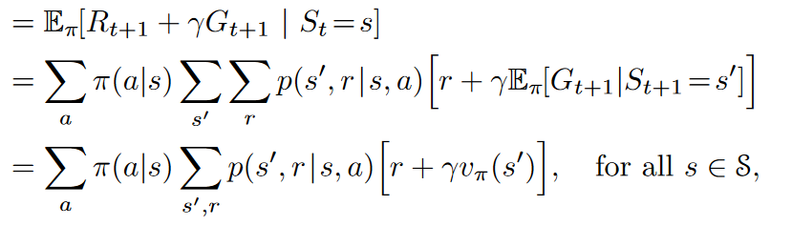
The Bellman Equation
Notes:
The definition as it stands is intuitive but not useful mathematically. The Bellman equation formalizes the definition of the value function into an equation that refers to specific states and actions.

Slide 14
Dynamic Programming
If the environment’s dynamics are completely known, the Bellman equation provides a system of |S| linear equations in |S| variables
Solving the equations yields the optimal value function.
What if an exact solution to the equations is infeasible?
Notes:
The Bellman equation is solvable as a system of s linear equations in s variables and yields the value of each state.
Many problems have prohibitively large state spaces.

Slide 15
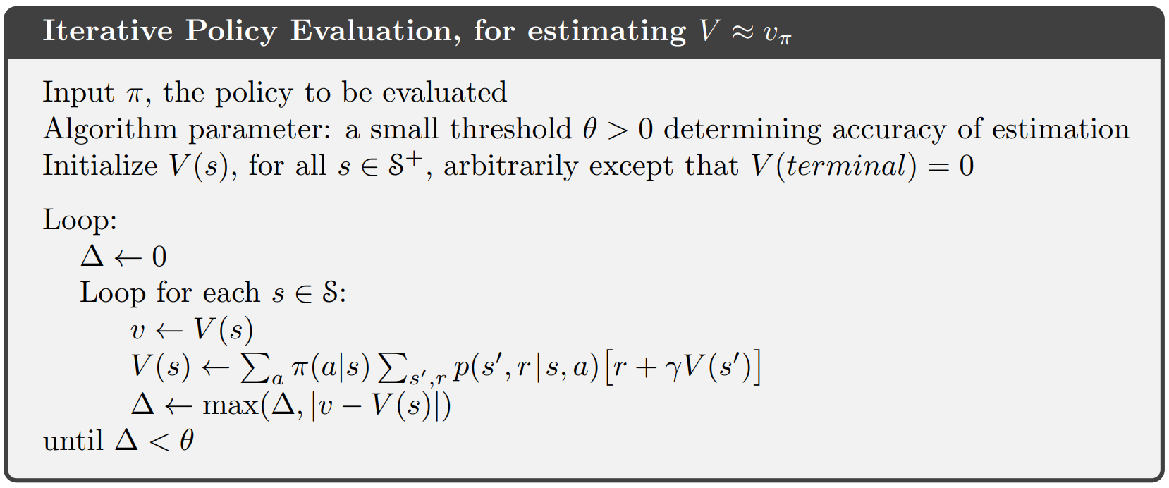
Dynamic Programming
Use the Bellman equation as an update rule to iteratively compute the value of each state.
Notes:
After evaluating the policy, you can use the value function to improve the policy just like we did in the earlier example

Slide 16
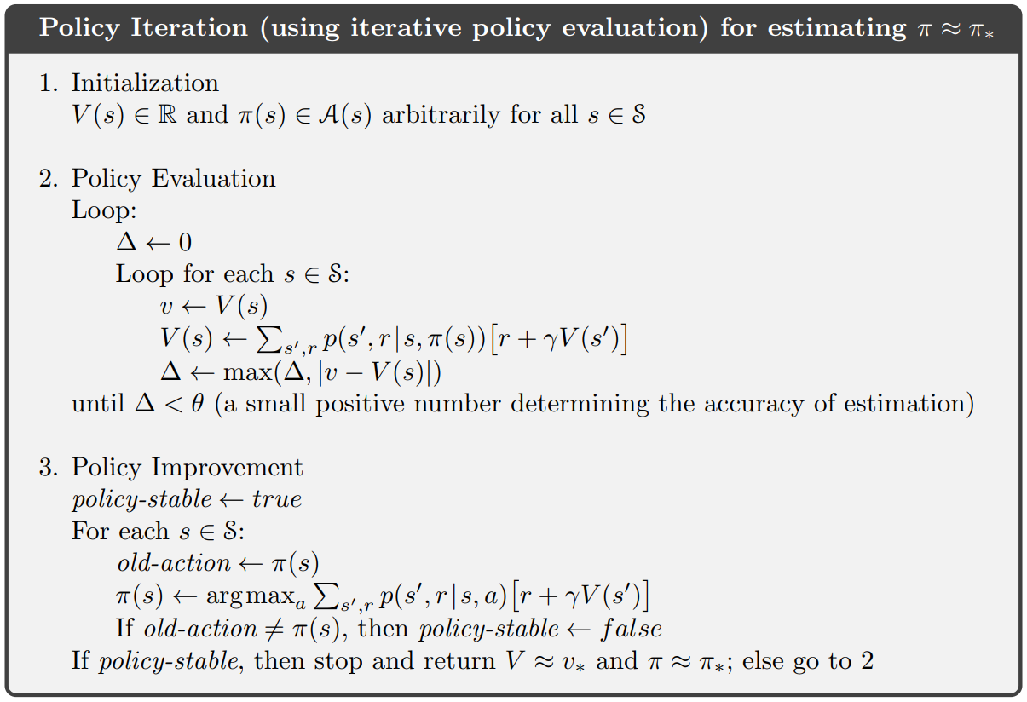
Dynamic Programming
Notes:
The red box encompasses policy evaluation which is exactly what was shown on the previous slide. Policy iteration
Simply adds a policy improvement step where the policy is updated to be greedy with respect to the newly-evaluated value function.

Slide 17
Dynamic Programming
Notes:
The red box encompasses policy evaluation which is exactly what was shown on the previous slide. Policy iteration
Simply adds a policy improvement step where the policy is updated to be greedy with respect to the newly-evaluated value function.
Because we are now approximating the value function in policy evaluation, we can derive the true values of the optimal value function only in the limit. Which theta should we choose? It’s a time/accuracy tradeoff.
One extreme (but viable) answer is to perform only a single iteration of policy evaluation, as seen in value iteration.

Slide 18
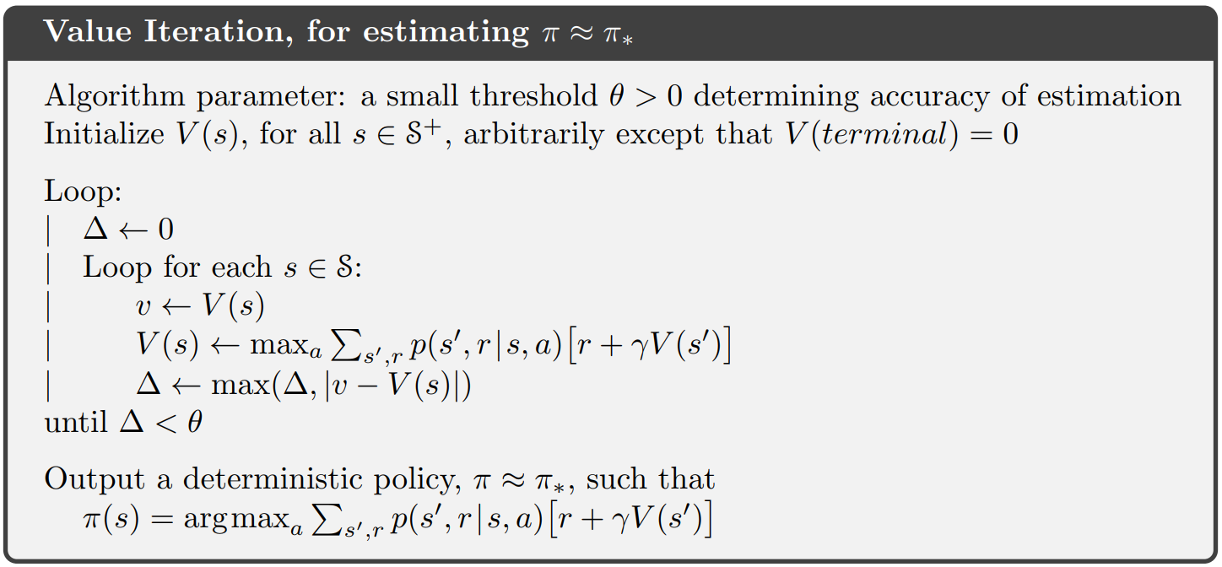
Dynamic Programming
Notes:
This essentially evaluates the value function for the policy in which the probability of all actions is zero except for the action that maximizes the expected return. Therefore, policy improvement is built in to the update step or, put another way, exactly one round of policy evaluation occurs between subsequent policy improvements.

Slide 19
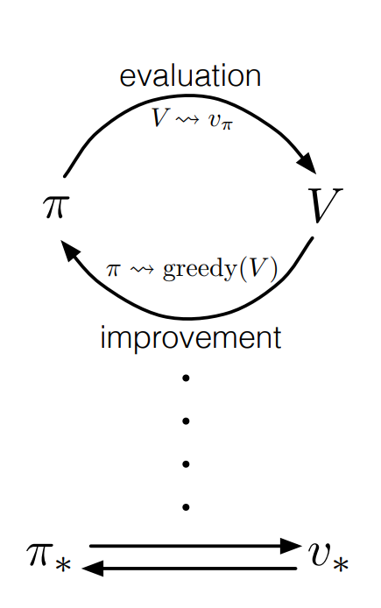
Generalized Policy Iteration (GPI)
Notes:
Value iteration is a special case of Generalized Policy Iteration, which is a paradigm used in almost all of the examples in this lecture. The information in the previous slides should be sufficient to understand what this diagram is describing.

Slide 20
Monte Carlo Methods
What if we do not have complete knowledge of the environment? How can we compute the update term
If the quantities p, s’, r, a are unknown?
We ‘learn’ the value of each state from observations of many actor-environment interactions.

Slide 21
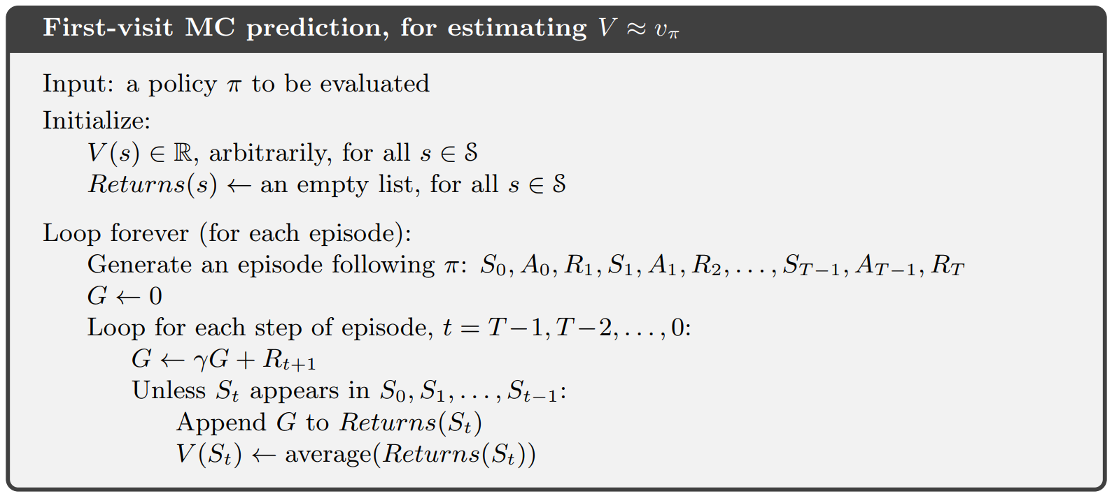
Monte Carlo Methods
Notes:
Without a model, the value function does not contain sufficient information to derive a policy from; how will you know what states are accessible and by which actions given your current state? It is impossible to chose an optimal action.
If you estimate the value of state-action pairs, however, your learned model inherently considers the unknown transition probabilities. Choosing the optimal action is as easy as selecting the maximum over all state-action pairs that incorporate your current state and available actions.

Slide 22

Terminology – Action-Value Function
…
r_{a|s}
s_{n}
a
s_{n+1}
…
Notes:
Formal definition of the action-value function Q_pi(S, A)

Slide 23
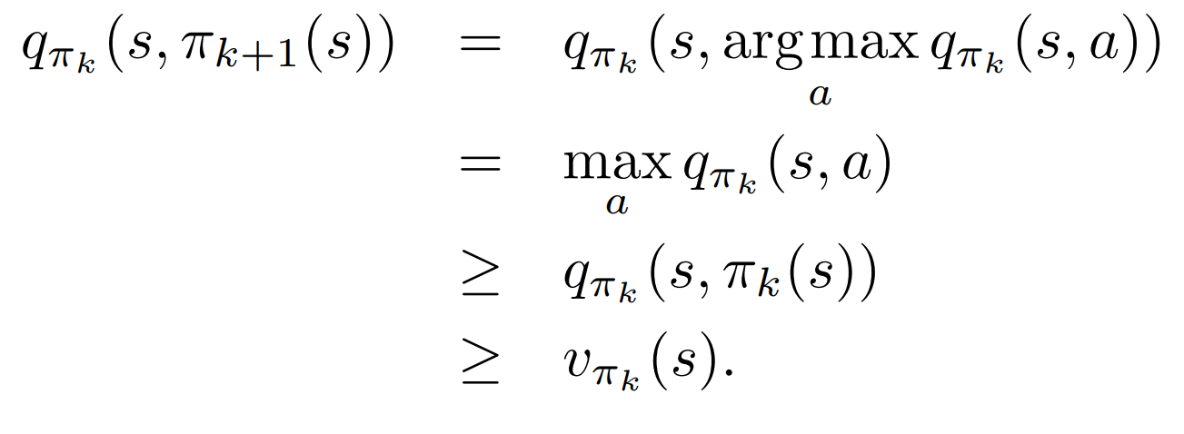
Terminology – Action-Value Function
Notes:
GPI still applies to action values!
Policy improvement can be done by constructing pi_k+1 as the greedy policy with respect to q_pi_k.
In this case, the new policy meets the requirements of being ‘equal to or better than’ the original policy (equal to only in the case that both are optimal).

Slide 24
ε-soft Action Selection
r=1
q(s,a)=0
S_{t}
r=2
q(s, a) = 0
Notes:
ALWAYS picking the state, action pair with the greatest expected return is extremely detrimental to the learning process. Assume this simple one-state, two action problem. You randomly choose an action which happens to be the top one with r=1.

Slide 25
ε-soft Action Selection
r=1
q(s,a)=1
S_{t}
r=2
q(s, a) = 0
Notes:
You update the reward expectation of the top action to 1.
Next episode, you choose from the two actions again, selecting the action with the greatest expected return. Which do you choose?
Note that under the greedy policy, the lower action will never even be sampled. The learning algorithm has failed on the simplest conceivable problem. Everything could be solved if the algorithm sampled the lower action enough to learn that it was better.
Solutions:
Optimistic initial values
Epsilon-soft policies

Slide 26
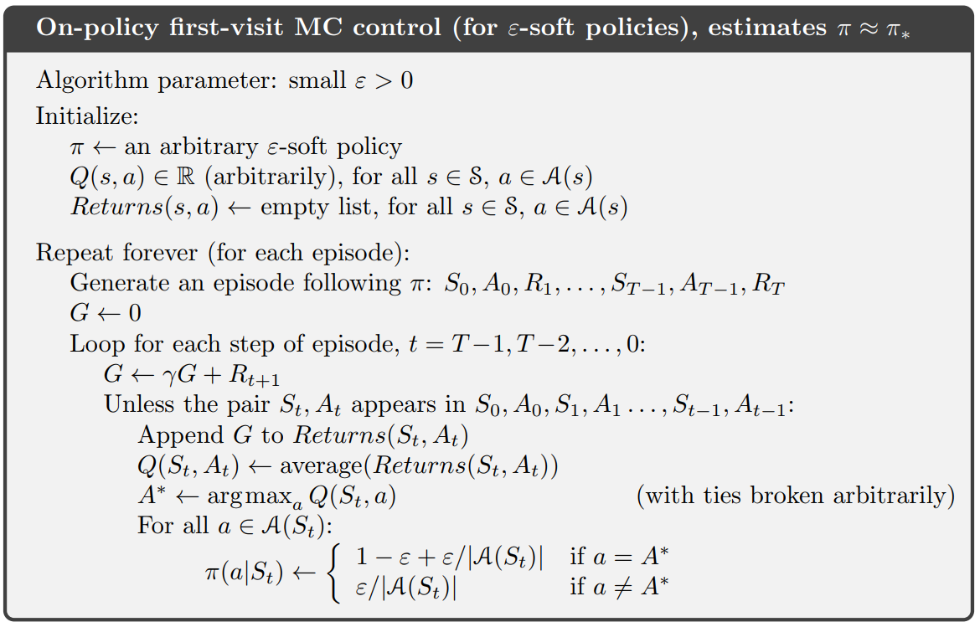
Monte Carlo Methods
Notes:
Earlier we saw Monte-Carlo policy evaluation with respect to the value function.
Now we can view a Monte-Carlo implementation that uses the action-value function alongside an epsilon-soft policy to perform GPI.
There is a subtle flaw in using an epsilon-greedy policy to control your agent, however.
It might be fun to guess what it could be before I show the next slide.

Slide 27
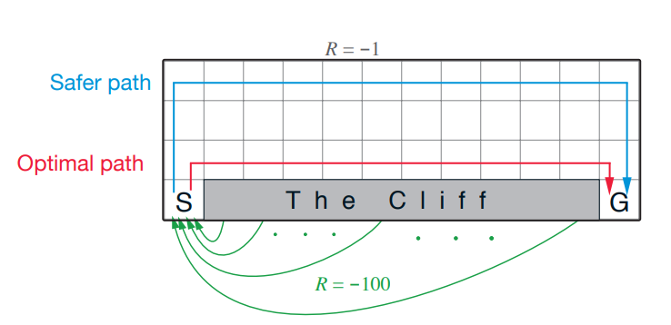
Monte Carlo Methods
Notes:
The algorithm learns the action-value functions for the epsilon-greedy policy which incorporates a small proportion of random actions. Therefore, the method ‘learns’ the risks associated with random action taking.
Even if you waited for the epsilon-greedy method to converge and then constructed a new greedy policy using the computed action-value function, you would end up with a sub-optimal policy.

Slide 28
Monte Carlo Methods (Off-policy)
Off-policy methods simultaneously maintain two different policies with different functions:
The behavior policy is used to control the agent.
The target policy is evaluated and optimized (using the returns observed while following the behavior policy).
It is possible for the behavior policy to be ε-soft and the target policy to be greedy!
Notes:
Without a model, state values are insufficient to derive a policy -> how will you choose an action to get to the desired state?
If you estimate the value of state-action pairs, however, your learned model considers the unknown transition probabilities.

Slide 29
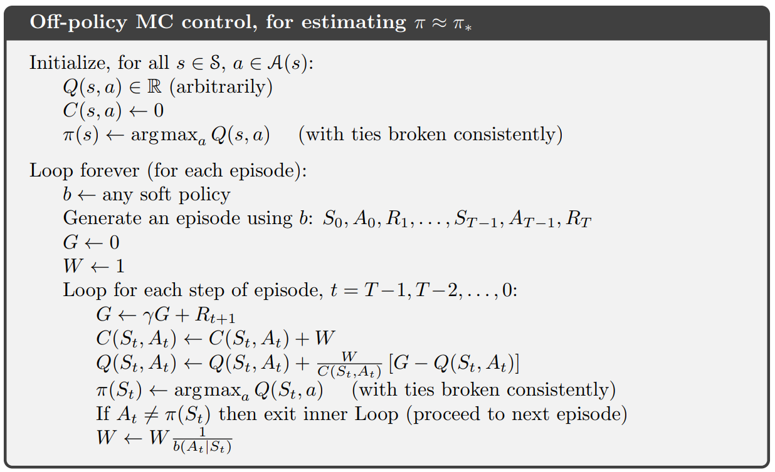
Monte Carlo Methods (Off-policy)
Notes:
W is used for importance sampling, which accounts for the fact that the probability distributions for the actions of any
Given state are likely different under the two policies. Smaller updates are made to the action-value function following
Highly probable actions to compensate for the fact that such updates will occur more frequently.
Importance sampling is an important concept for Monte Carlo methods that effectively reduces the
Variance of the action-value estimates for the target policy. There are many improved implementations
Of importance sampling that are complicated and beyond the scope of this presentation.

Slide 30
Temporal Difference Learning
Must we wait for the end of an episode to update our (action)-value function?
What if our episode has one million transitions?
What if:

Slide 31
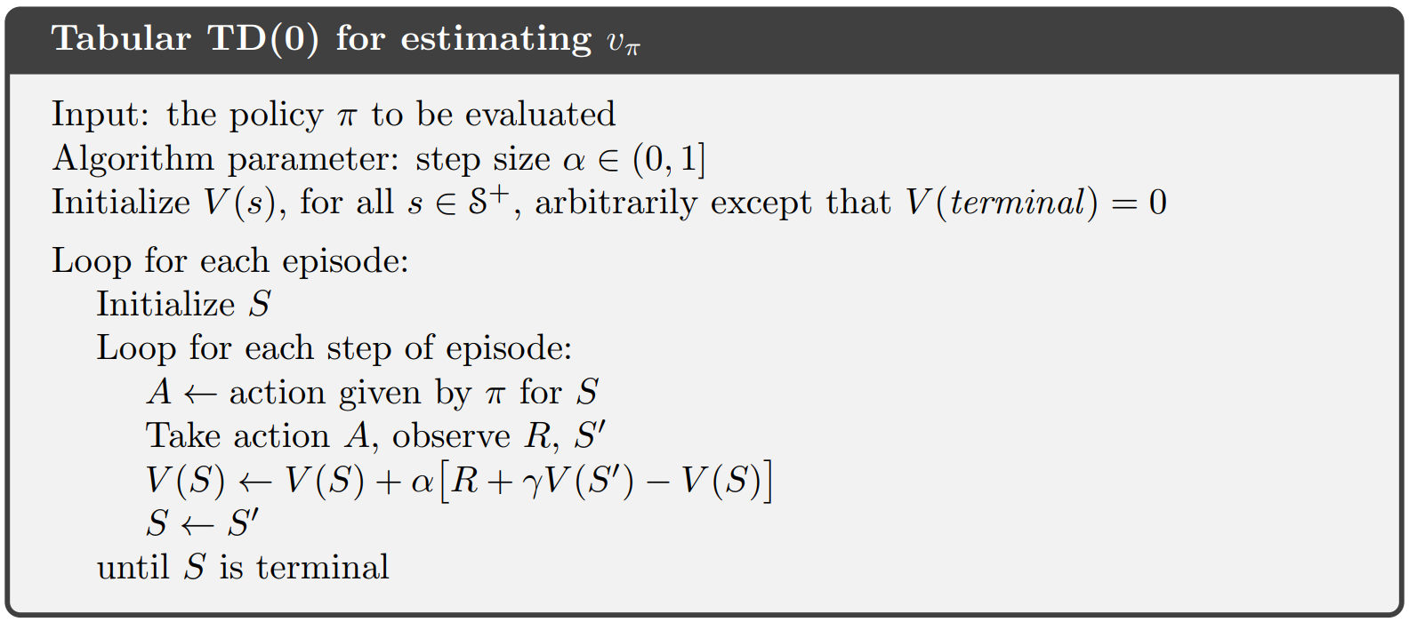
Temporal Difference Learning

Slide 32
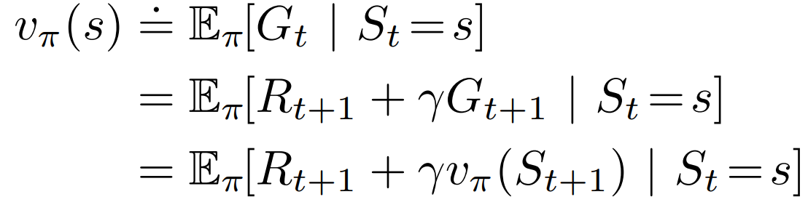
Temporal Difference Learning
Update target for Monte Carlo Methods
Update target for Temporal Difference (TD)
TD error
Notes:
Although update targets for MC and TD are mathematically equivalent, the implementation of their update rules causes them to converge on different targets that are only equivalent given an infinite number of training episodes.

Slide 33
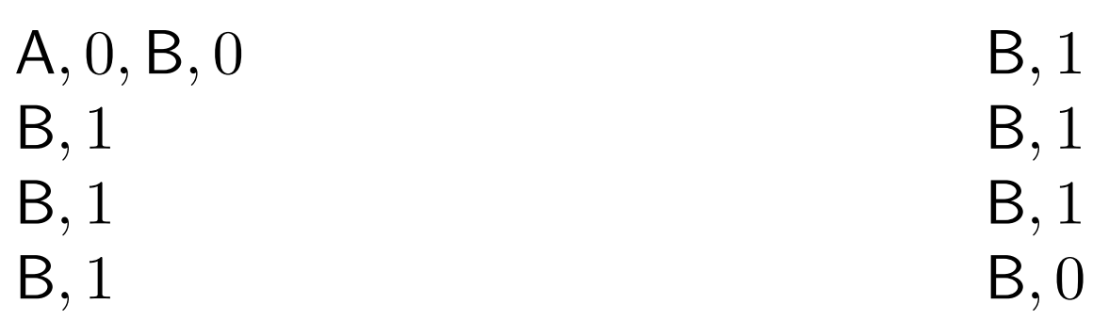
Temporal Difference Learning
You are the predictor!
Observed episodes:
Notes:
Assume a finite number of observations. Present experience repeatedly until the algorithm converges on an answer.

Slide 34
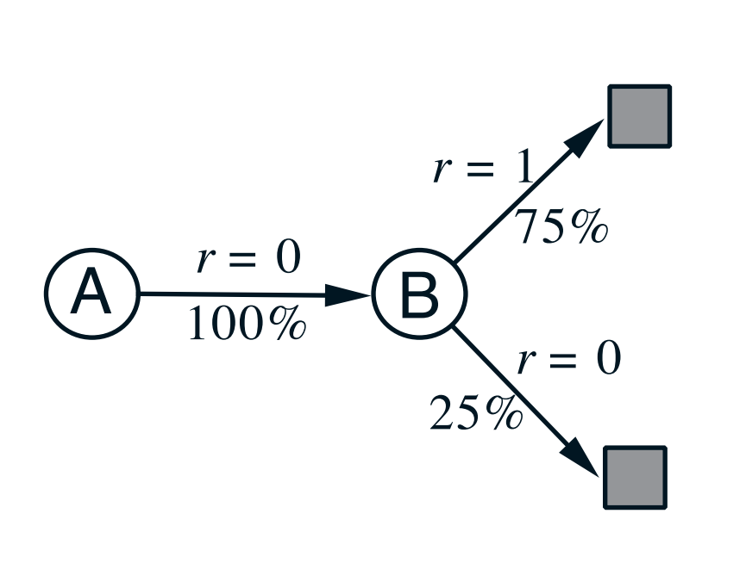
Temporal Difference Learning
Notes:
Batch Monte Carlo methods always find the estimates that minimize mean-squared error on the training set, whereas batch TD(0) always finds the estimates that would be exactly correct for the maximum-likelihood model of the Markov process.
the maximum-likelihood model is the model of the Markov process formed in the obvious way from the observed episodes: the estimated transition probability from i to j is the fraction of observed transitions from i that went to j, and the associated expected reward is the average of the rewards observed on those transitions. Given this model, we can compute the estimate of the value function that would be exactly correct if the model were exactly correct. This is called the certainty-equivalence estimate. In general, batch TD(0) converges to the certainty-equivalence estimate as the maximum likelihood model moves toward the real

Slide 35




Temporal Difference Learning
On-policy TD policy evaluation:
How can we modify this to learn the action-value function so that we can perform policy iteration?
Just replace V(S) with Q(S, A)
$$Q(S,A)$$
$$Q(S,A)$$
$$Q(S′,A′)$$
$$Q(S,A)$$

Slide 36



Temporal Difference Learning
On-policy TD policy evaluation:
How can we modify this to learn the action-value function so that we can perform policy iteration?
Just replace V(S) with Q(S, A)
$$Q(S,A)$$
$$Q(S,A)$$
$$R$$
$$Q(S′,A′)$$
$$Q(S,A)$$

Slide 37
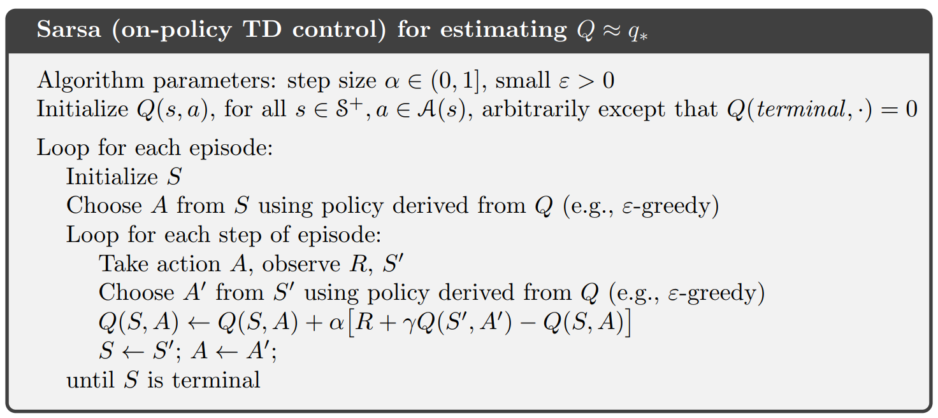
Temporal Difference Learning

Slide 38
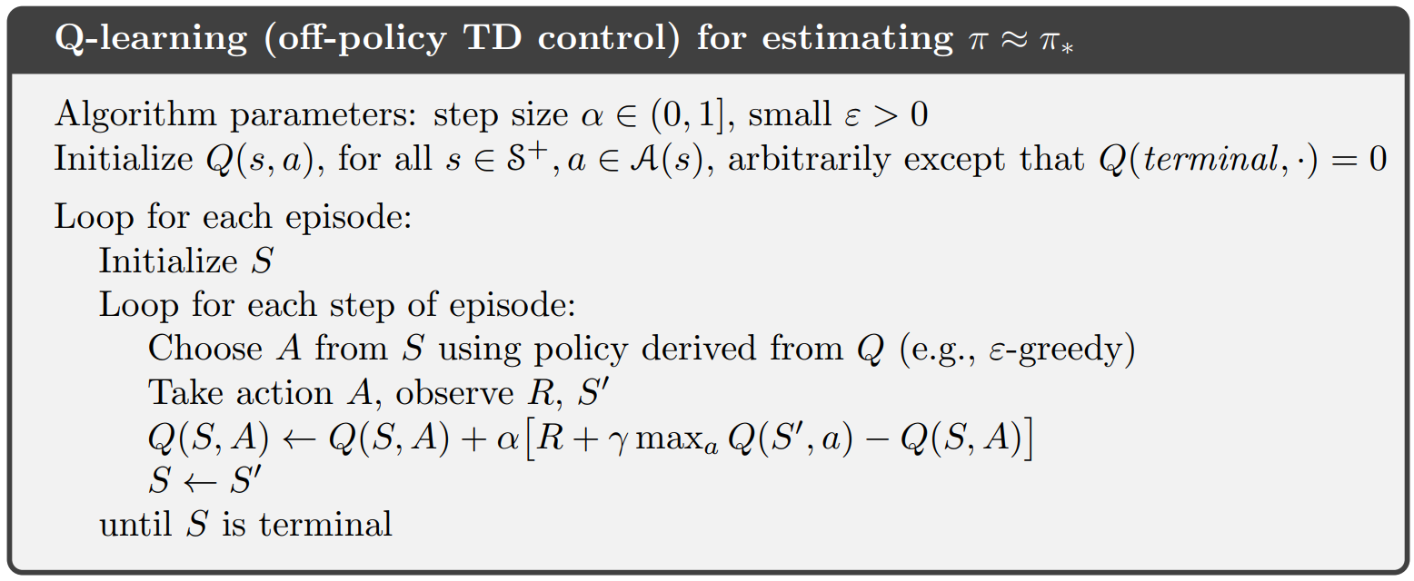
Temporal Difference Learning
Notes:
Approximates Q*

Slide 39
Temporal Difference Learning
Notes:
Without a model, state values are insufficient to derive a policy -> how will you choose an action to get to the desired state?
If you estimate the value of state-action pairs, however, your learned model considers the unknown transition probabilities.

Slide 40
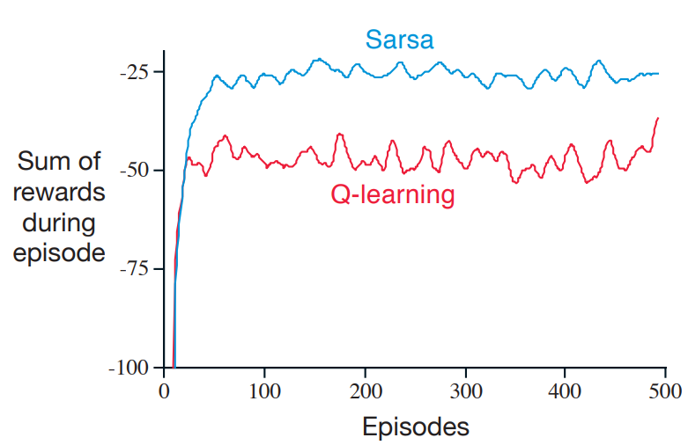
Temporal Difference Learning
Notes:
Approximates Q*

Slide 41
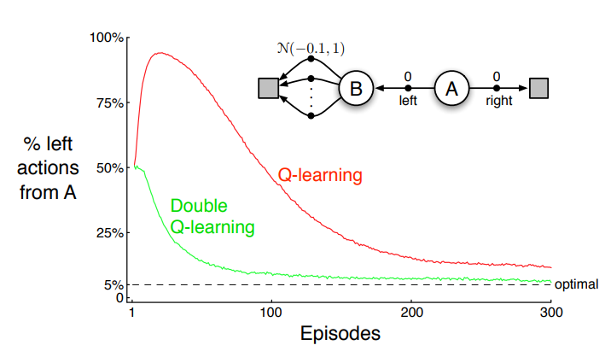
Double Learning
Notes:
Second problem associated with taking the max action

Slide 42
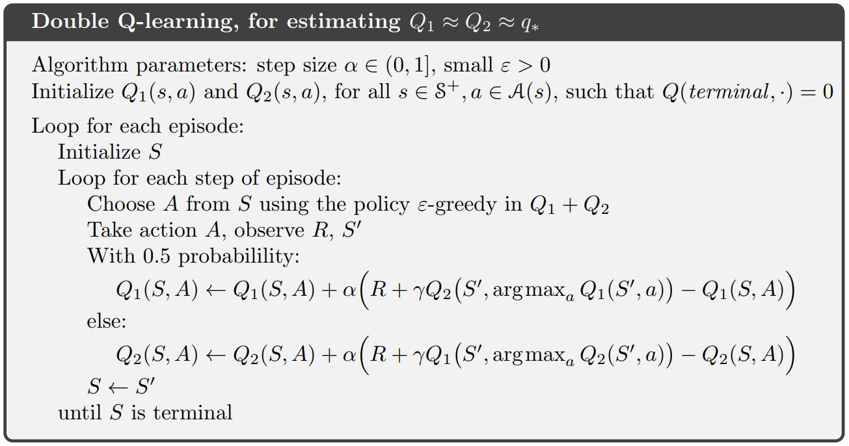
Double Learning
Notes:
Second problem associated with taking the max action

Slide 43
Double Learning
Notes:
Second problem associated with taking the max action

Slide 44
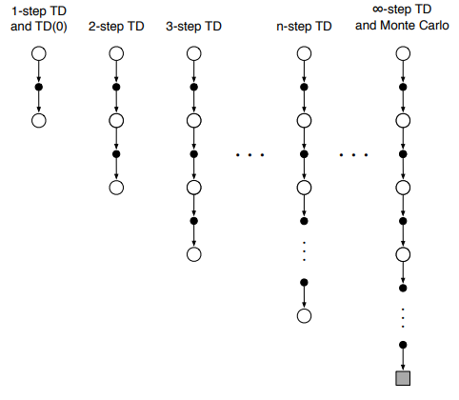
N-step TD Methods
Notes:
Second problem associated with taking the max action

Slide 45
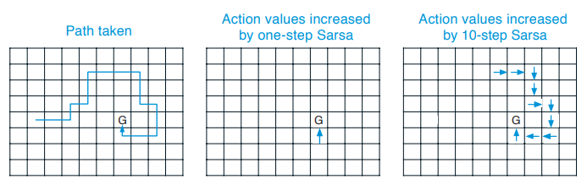
N-step TD Methods
Notes:
Second problem associated with taking the max action

